Slide 1
DB25-relay-HV-control
Lafe Spietz
NIST
Summer 2024

Slide 2
Bill of Materials
1 Mohm resistors
Relays
Headers
Dsub through hole connector

Slide 3
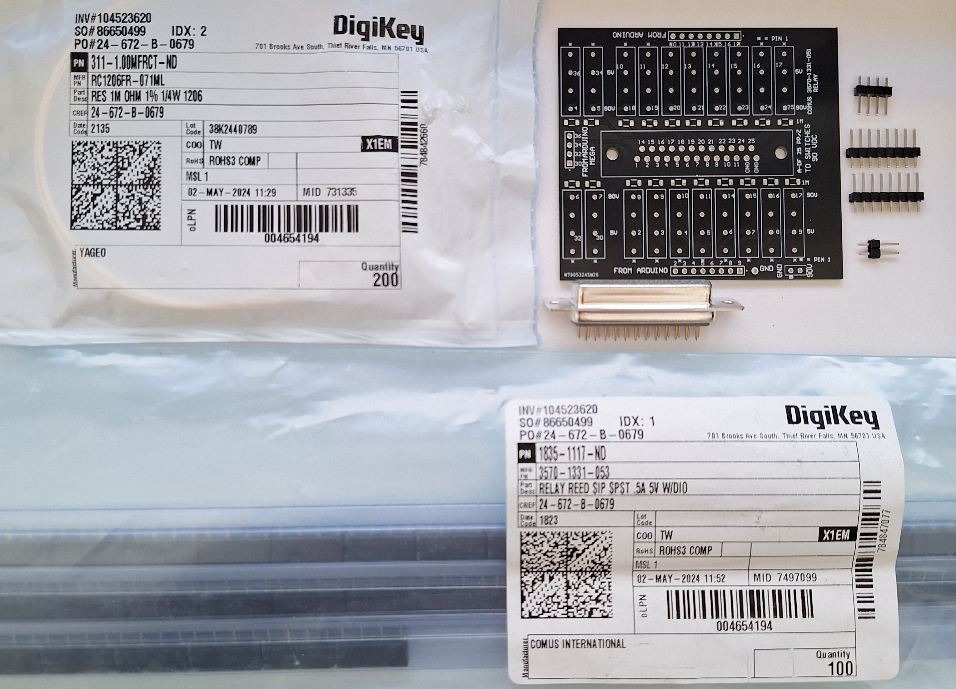
Kit

Slide 4
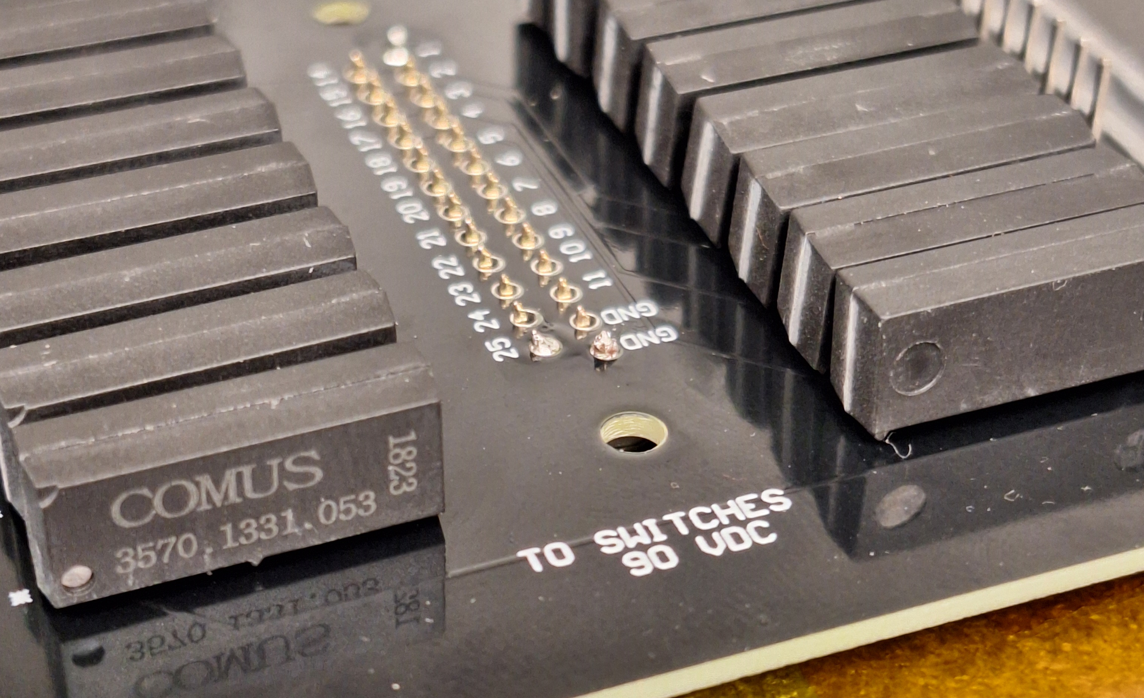
Lift board up when soldering to increase clearance

Slide 5
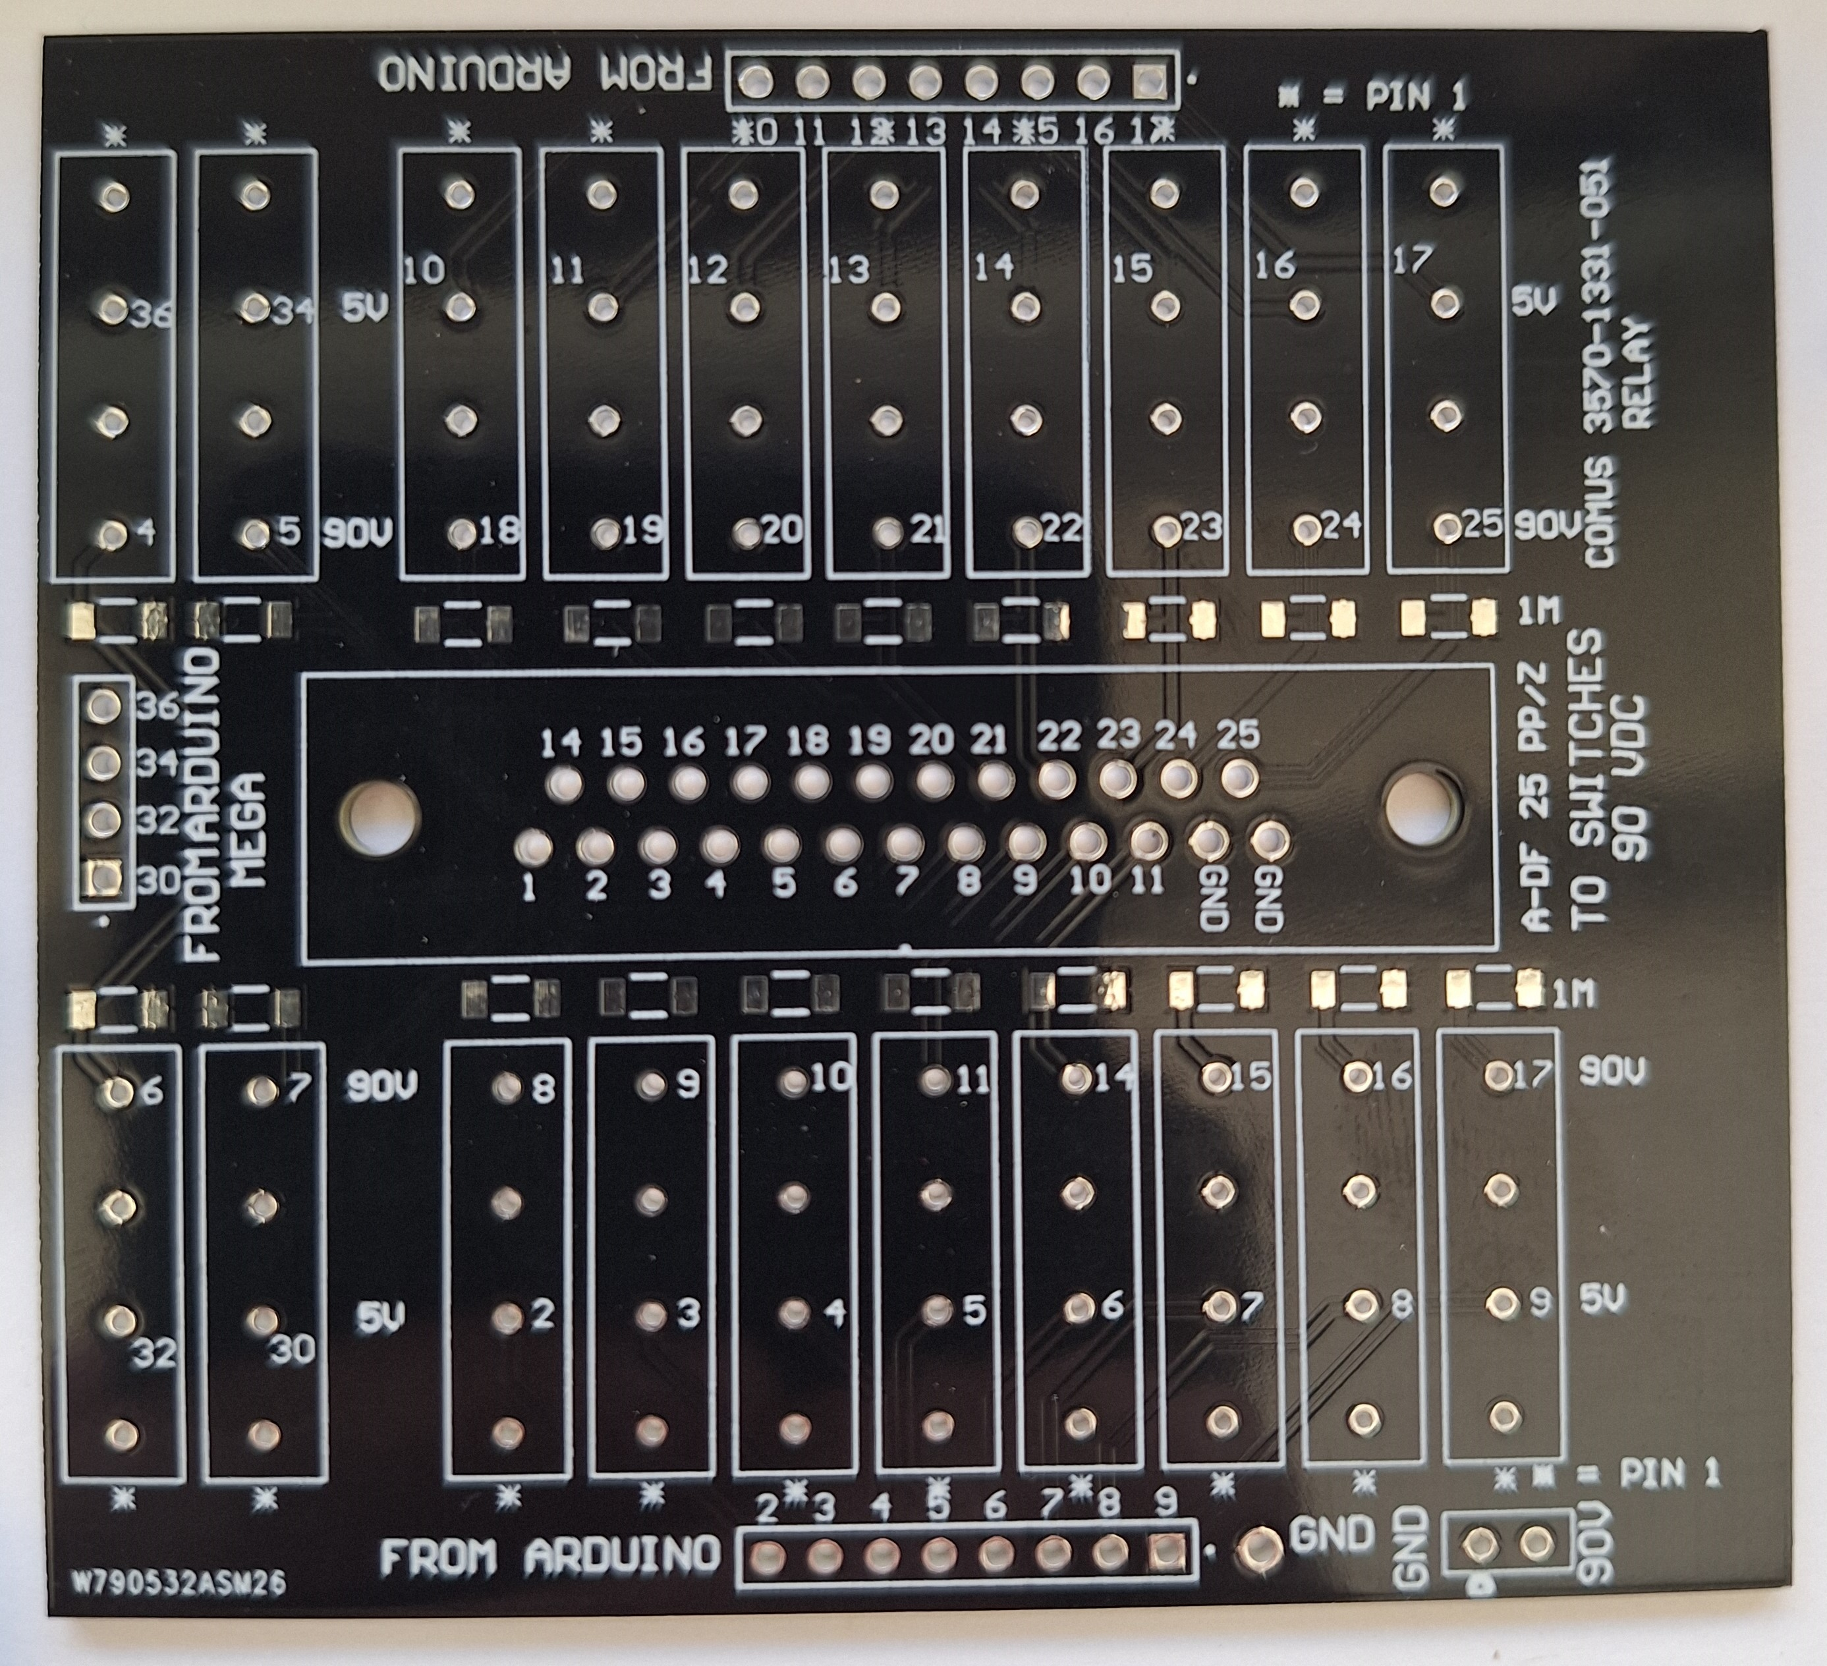
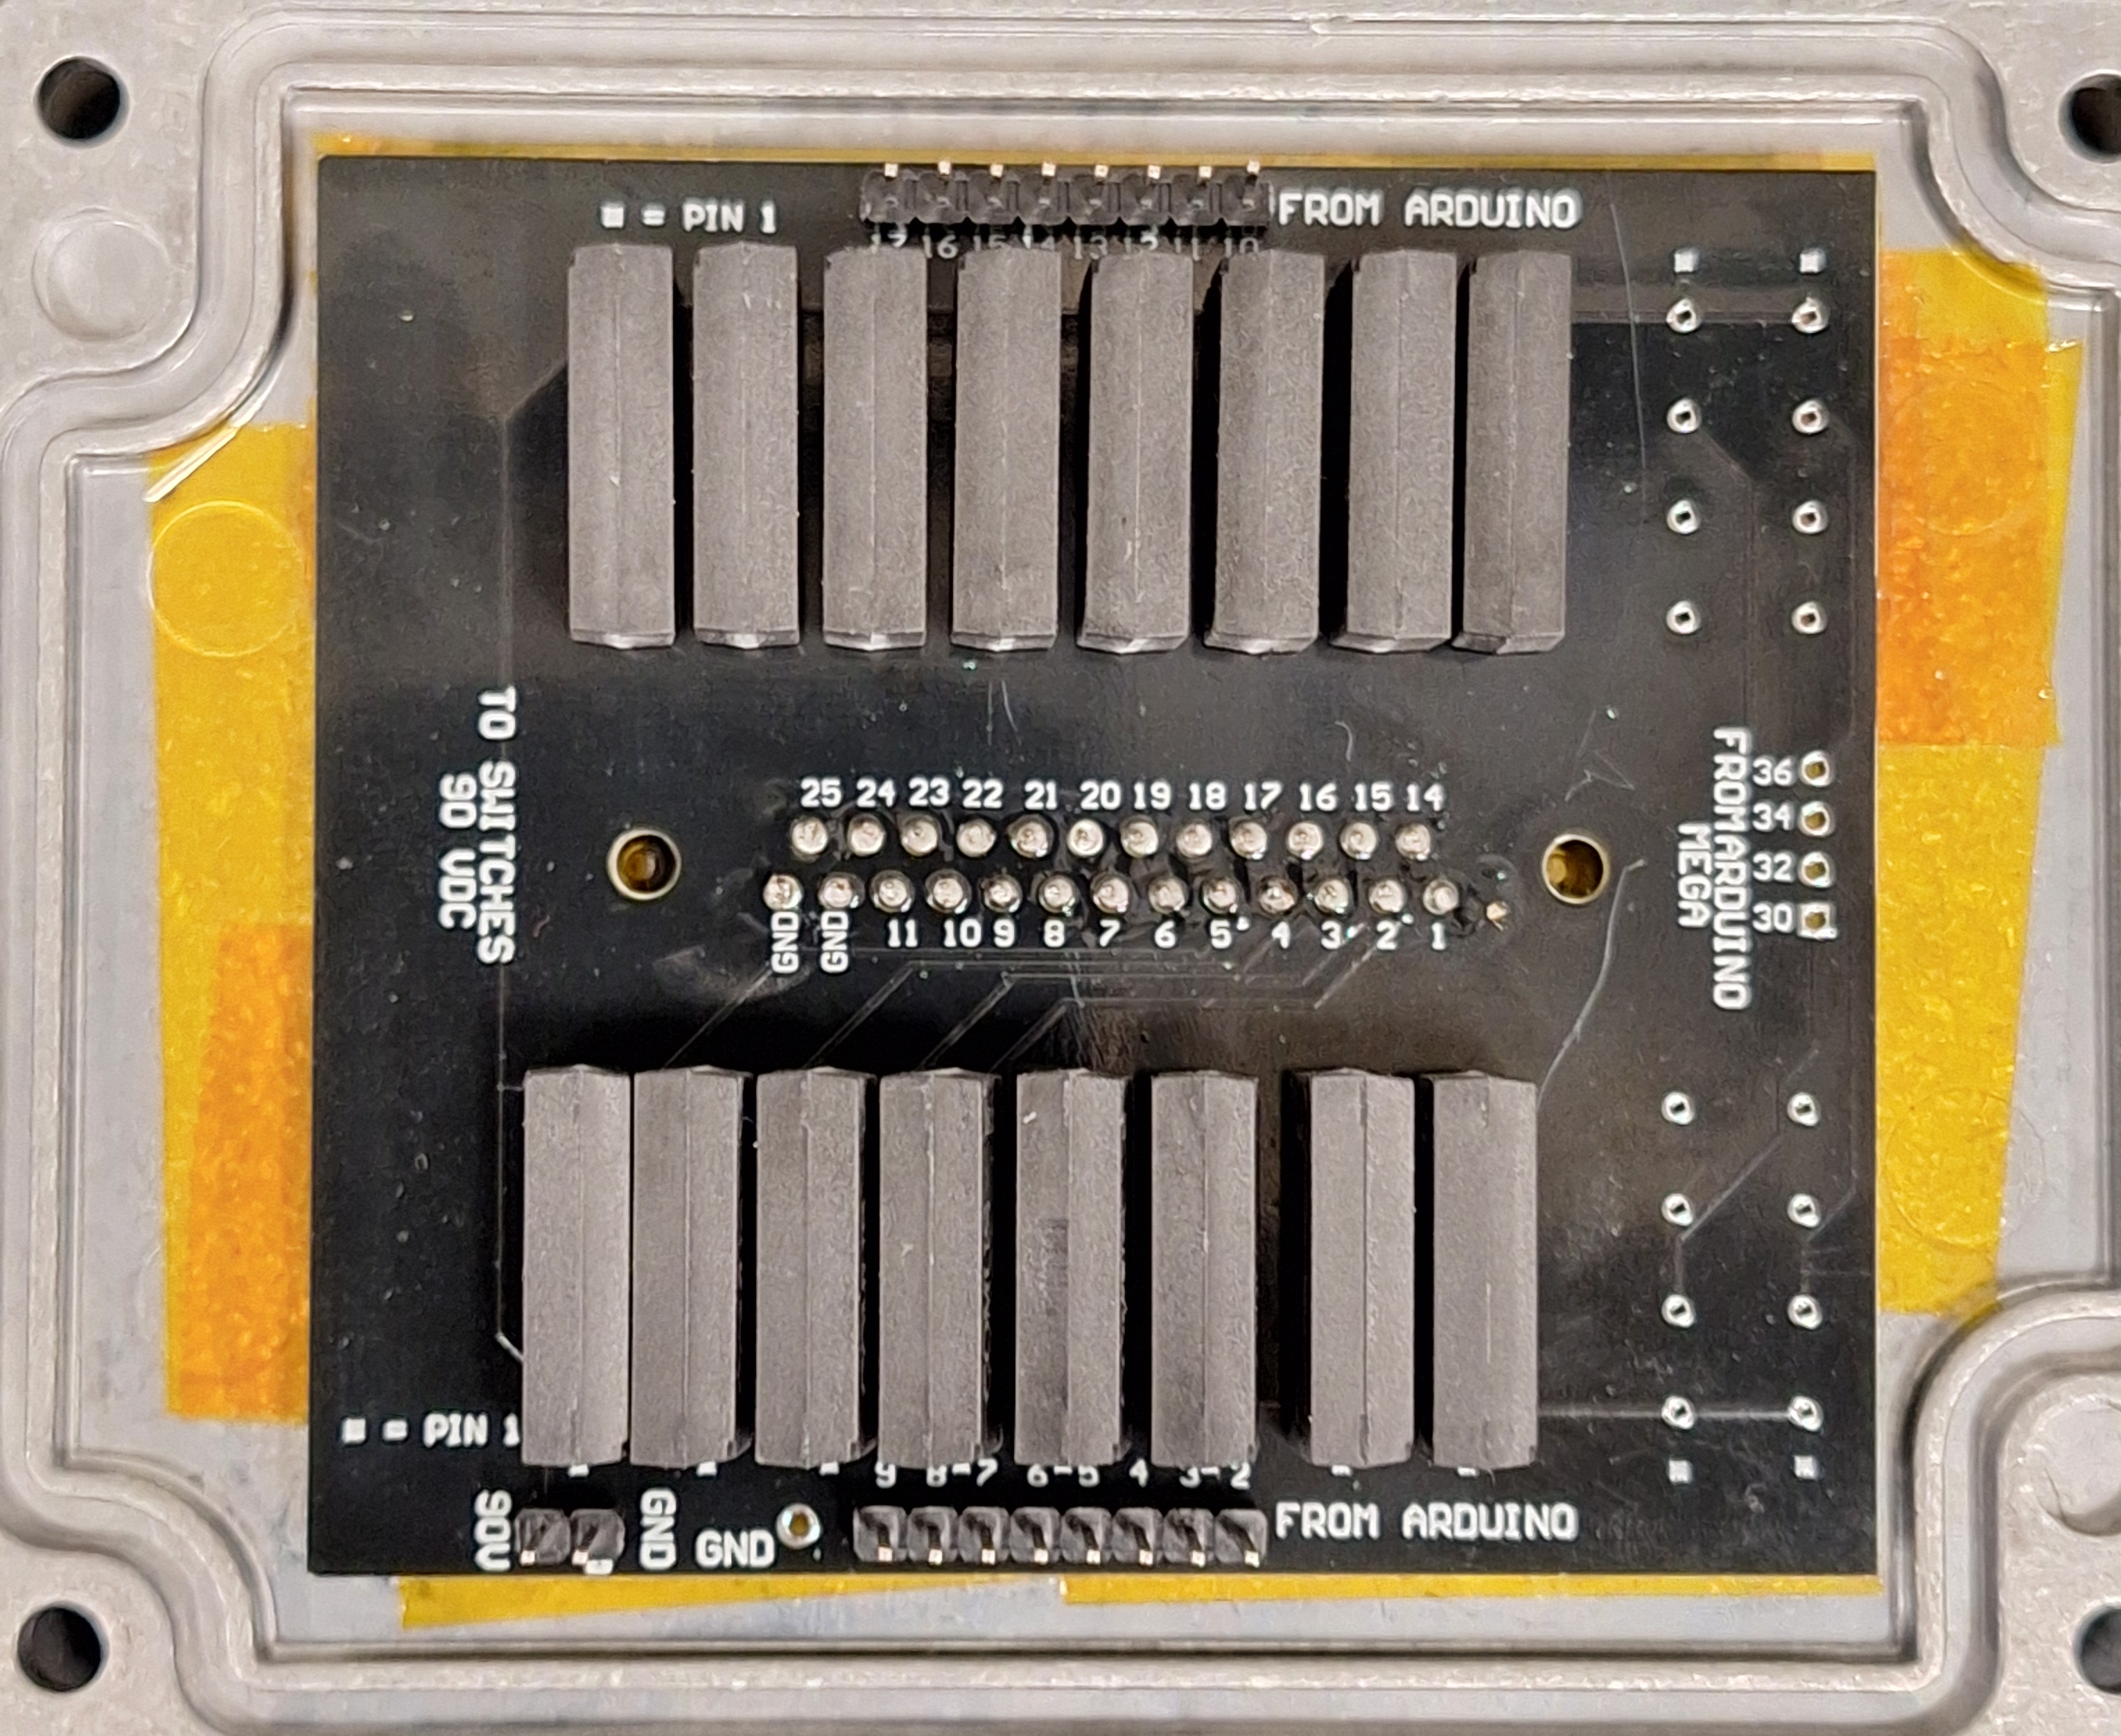
Assembly

Slide 6
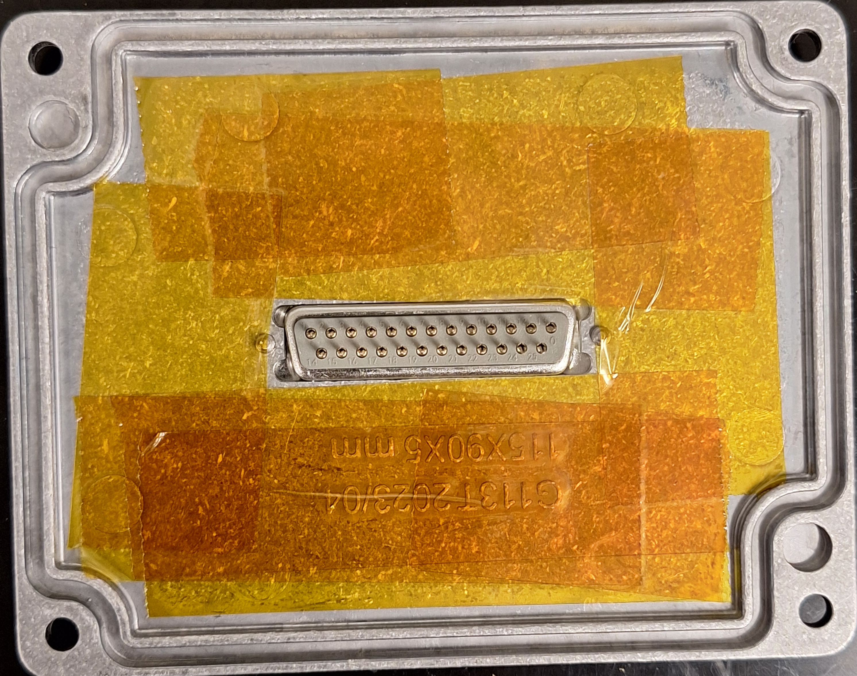
Adding polyimide tape to the lid
This must be assembled before the circuit board is soldered to the DB25 connector!
Prevent potential shorts

Slide 7
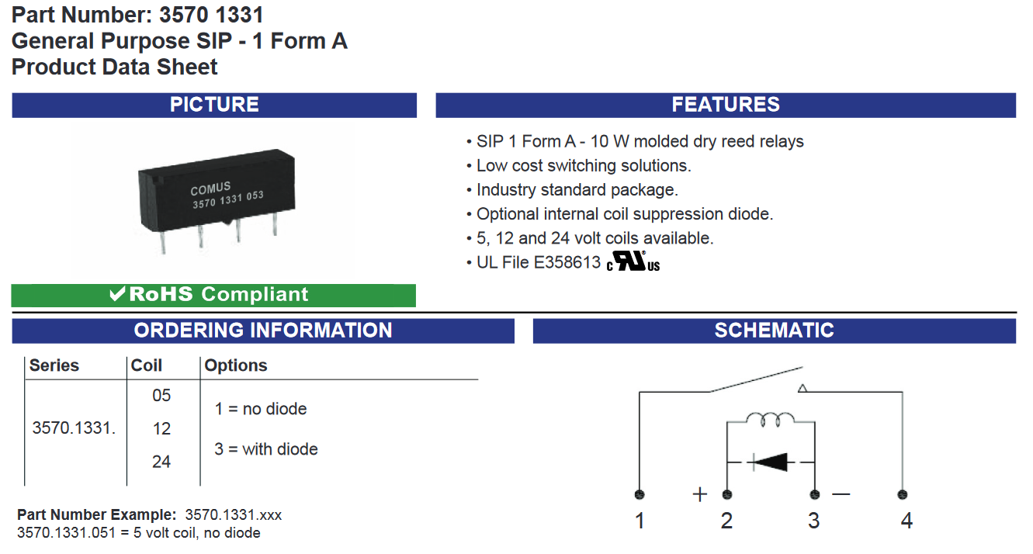
Relay

